Slide 1
What are the dangers and the positive affect of Artificial Intelligence on our society ?
By Loup MARQUEZ

Slide 2


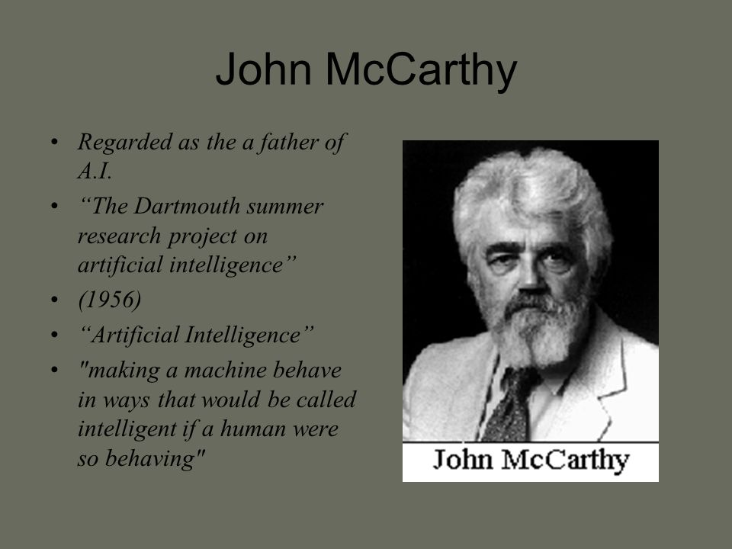
Early milestone in artificial intelligence
Definition of Artificial Intelligence.
Creator of Artificial Intelligence.
The most recognized benefactor of Artificial Intelligence.
First Artificial Intelligence programs.

Slide 3
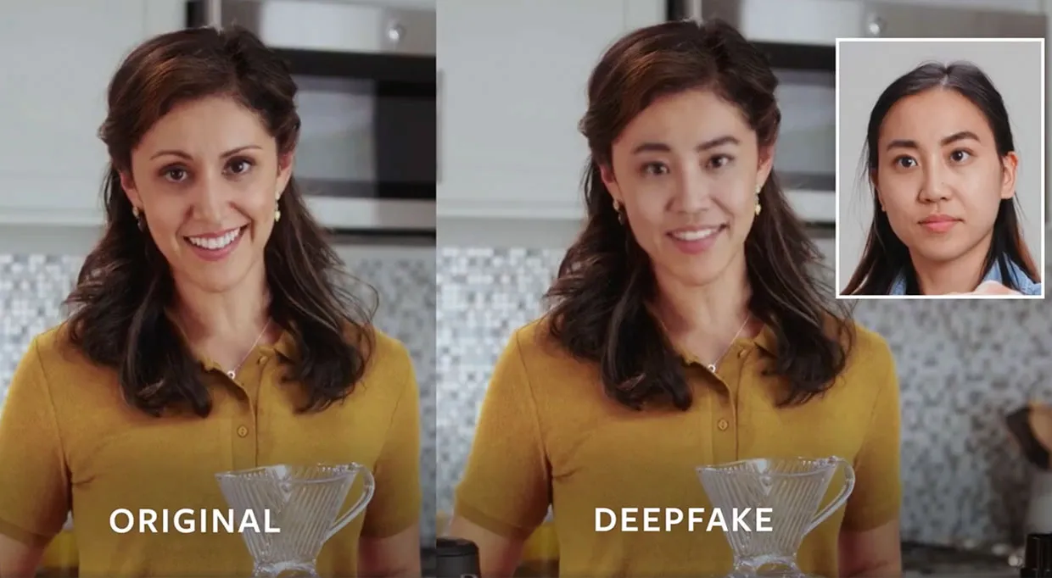
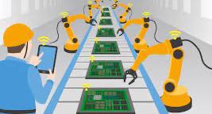
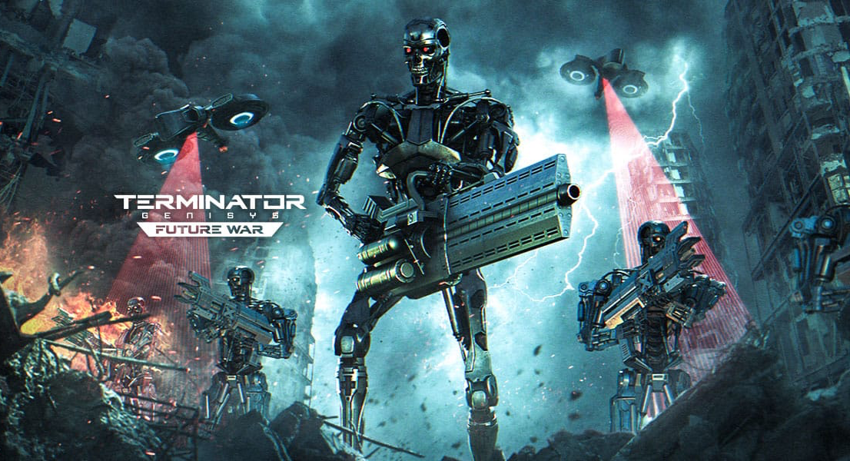
The Dangerous EFFECT on our society
Automation of Jobs
Spread of fake news
Stock Market Instability
AI-powered weaponry

Slide 4
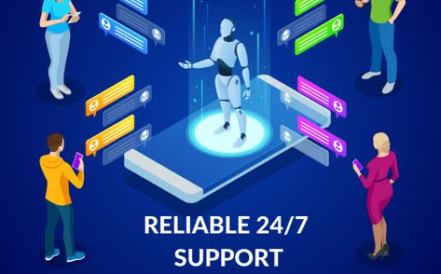
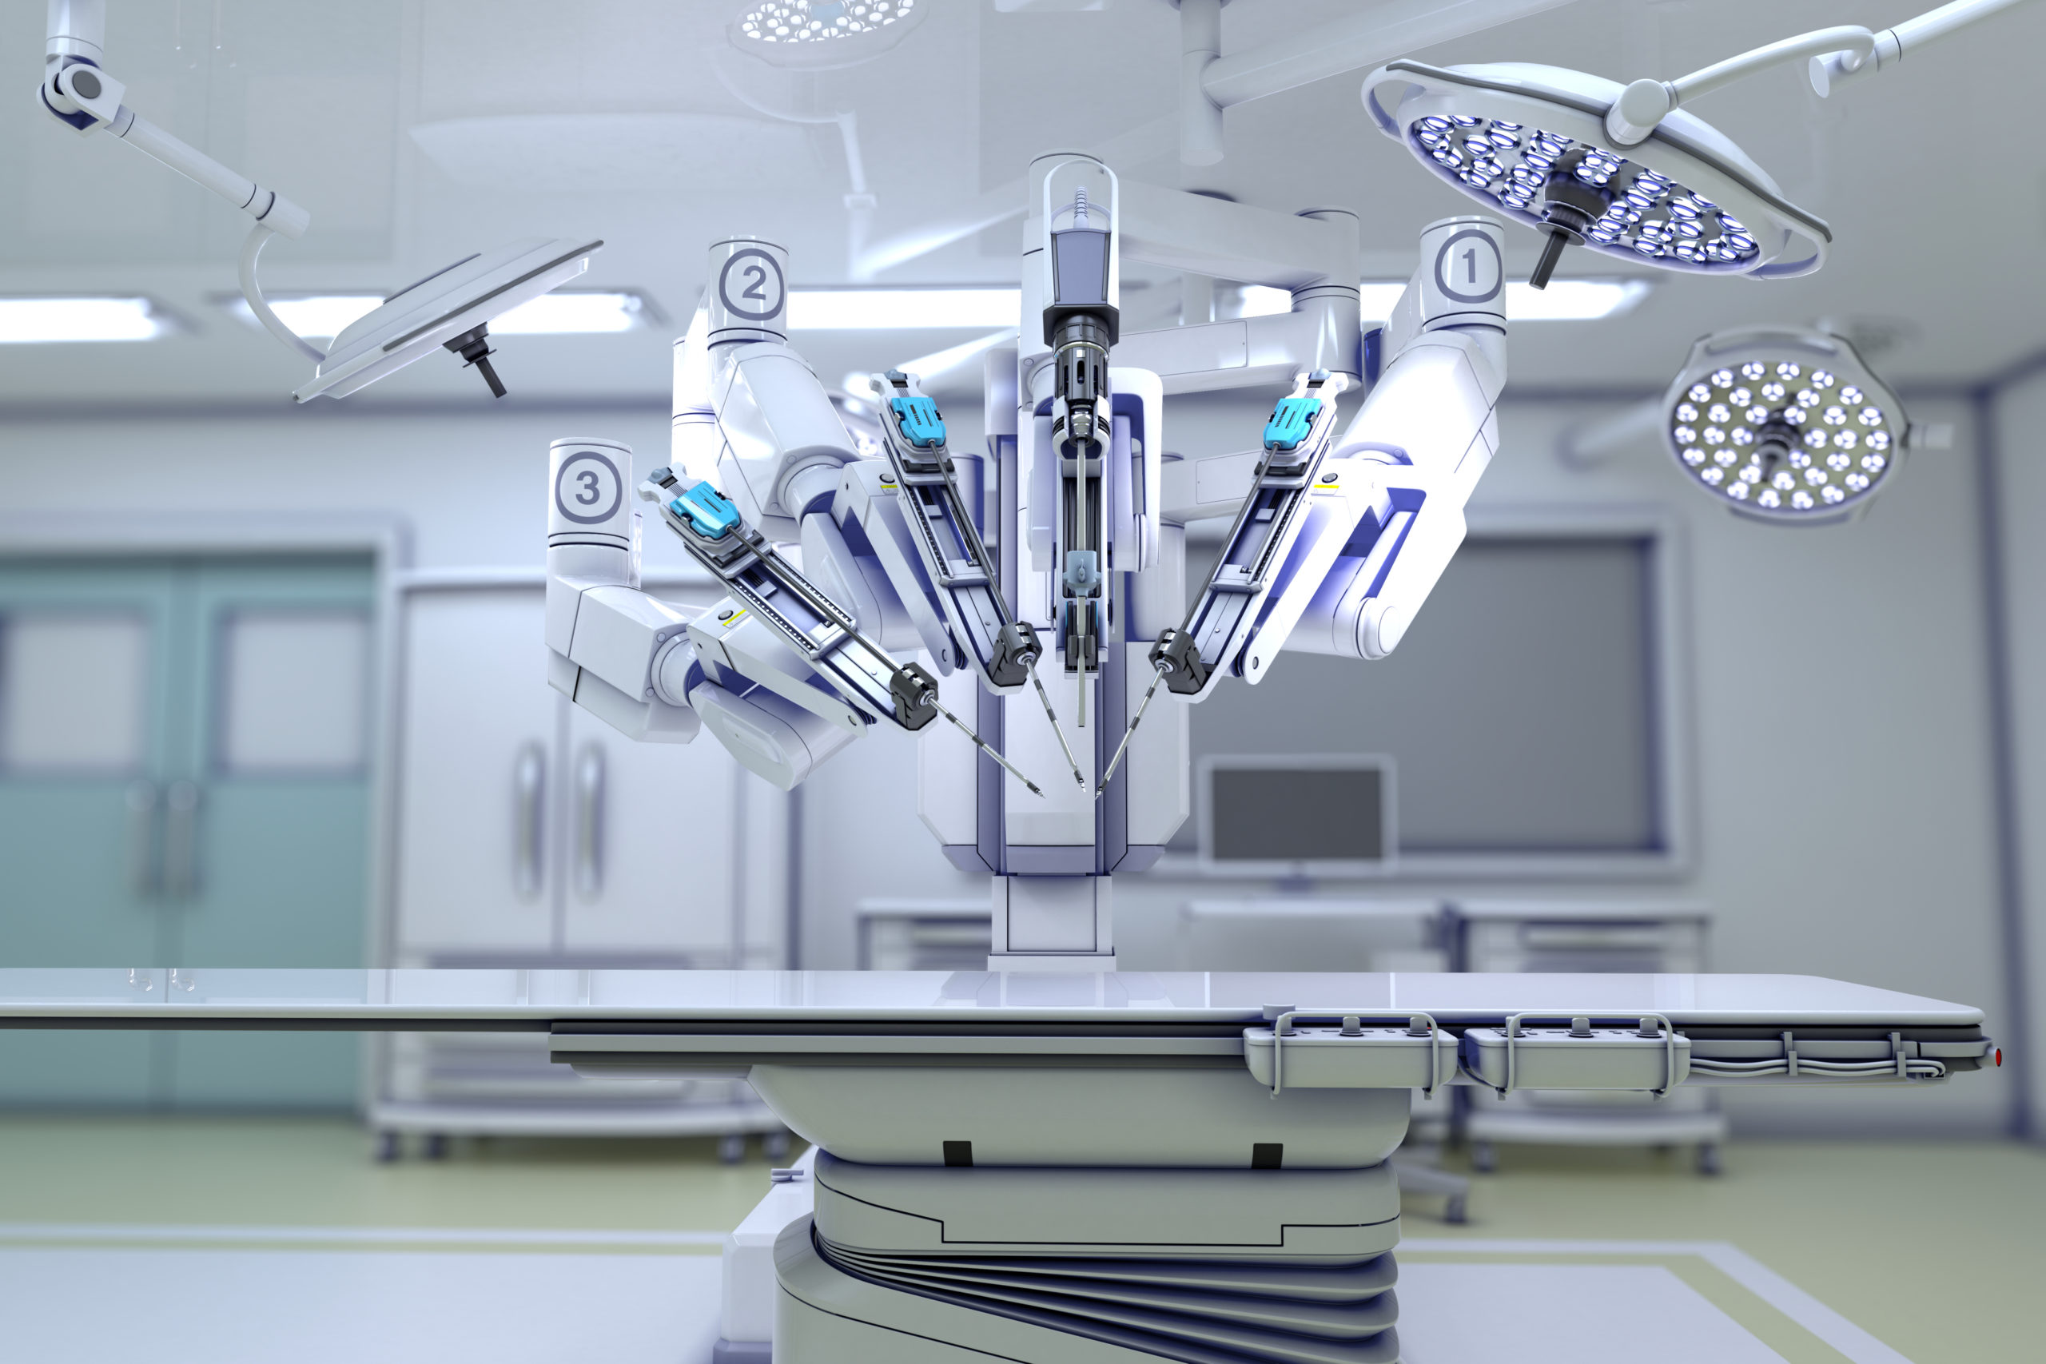
The positive affect on our society
Reduction of Human Error
24x7 Availability
Unbiased Decisions

Slide 5
Conclusion on Artificial intelligence
May hold the key to unlocking worlds secrets
Must be strictly Controlled

